Slide 1
Tiny House Project
11/25/15
Joseph Ou • Shivam Dave • Sargis Yonan • Reza Barghi • Sean Ashe
Sponsors: Zachary Graham at SOE and Tela Favaloro at IDEASS

Slide 2
Project Overview
Universities around California compete in SMUD’s Tiny House competition to make the most efficient tiny houses (under 400 sq ft)
Solar powered and “smart” tiny house project that will be implemented in the Watsonville area
Goal of the team is to create a modular sensor network for smart appliances, collect usage and environmental data, and analyze the data collected
We will continue to work on the project beyond this quarter

Slide 3
Goals
Intended goals:
Integrate sensors into a network & create a smart controller for them
Create a web dashboard that will handle data
Analyze data collected into the database
Achieved goals:
Integrated one type of sensor into a network
Created a wirelessly controlled smart water heater
Created a web dashboard that displays data and control inputs from the sensors
Adapted, modified, and added to the UCSC Greenwharf Project’s existing dashboard to display data relevant to our project

Slide 4
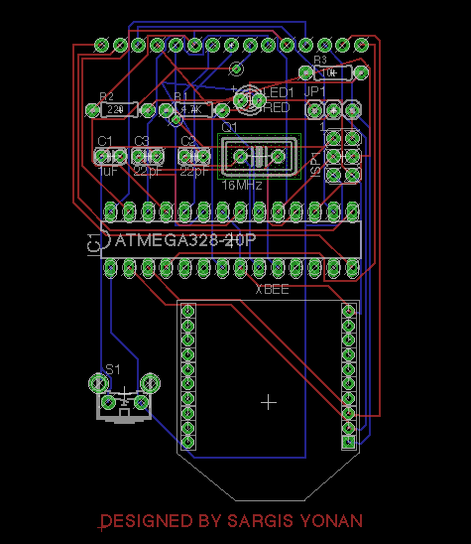
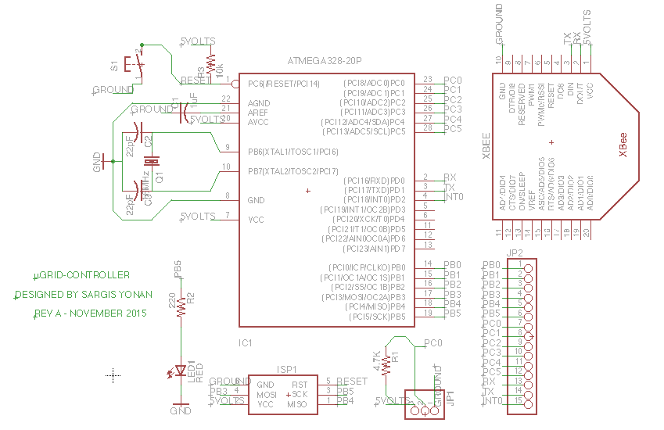

Slide 5
Challenges
Communicating between multiple sponsors and teams working on whole tiny house project
Balancing stories and tasks that are achievable within the quarter, and choosing ones that can be incorporated after the quarter
Learning technologies required by sponsors

Slide 6
Technologies
Programming Languages: C, Python
Web Framework: Javascript, HTML, CSS
Database: MySQL, PHP, SQLAlchemy
Equipment: ARM microcontroller with embedded Linux, AVR uCs, wireless emitters and receivers (IEEE 802.15.4), PCB design, and sensors

Slide 7
Project Management Techniques
Agile Methodology: Allowed the team to stay on top of developments
Clients’ requests required the team to be flexible and open to changes
Example: SQLalchemy → PHP
Scrum meetings held several times a week
Worked in a lab designated for the project
Communicated outside of SCRUM meetings through Hangouts and sponsor meetings/walkthroughs

Slide 8
What we liked/disliked
Enjoyed
Working with team that specialized in different areas
Seeing the application of the project in real life
Learning from sponsors about software development practices and current technology applications
Did not enjoy
Communicating with many people as a result of having sponsors, medium sized team, and large tiny house team
Scheduling meeting times with multiple groups of people for class and project sponsors
Difficulty in gaining access to equipment in timely manner; required lab training also

Slide 9
Lessons Learned
Will continue doing
Communicating with a large team requires everyone to be responsive
Being well prepared for team meetings reduces the time that they take
Will stop doing
Meetings that require all team members to be present but only focus on one aspect of the project, therefore wasting time for some members

